Slide 1
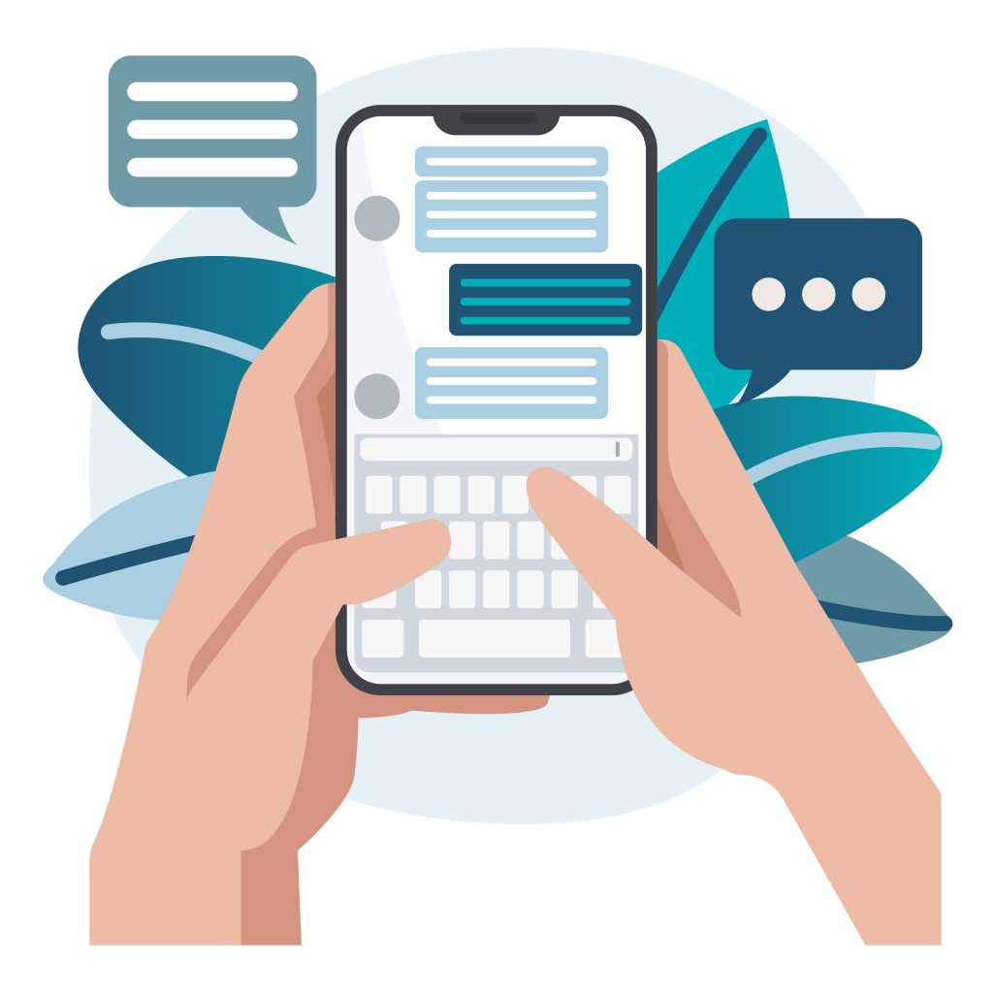
CHAT APPLICATION

Slide 2
INTRODUCTION
Messaging apps now have more global users than traditional social networks-which means they will play an increasingly important role in the distribution of digital journalism in the future.
A real-time chat application is a software application that enables users to exchange messages and communicate with each other in real-time. It allows individuals or groups to have conversations, share information, and collaborate instantly over the Internet.

Slide 3

OBJECTIVE
This project is to create a chat application for users to chat with each other’s.
To develop an instant messaging solution to enable users to seamlessly communicate with each other.
The goal is to create a web-based chat platform where users can join chat rooms, exchange messages in real-time, and have a smooth and interactive chat experience.

Slide 4
PROJECT CONTAINS
User Interface:
● Create an intuitive and visually appealing user interface for the chat application using HTML and CSS.
● Design a chat room interface with a list of available rooms, a message display area, and an input field for sending messages.
●Ensure responsive design to accommodate different screen sizes.

Slide 5
Chat Features:
● Allow users to send text messages in chat rooms.
● Provide a way to see who sent each message, and timestamp each message.
User Experience:
● Ensure a smooth and user-friendly experience with features like message scrolling and notifications for new messages.

Slide 6

Real-Time Communication:
● Implement real-time communication between users using JavaScript.
● Users should be able to select a chat room to join and exchange messages with other users in that room.
● Messages should appear in real-time without the need to refresh the page.

Slide 7
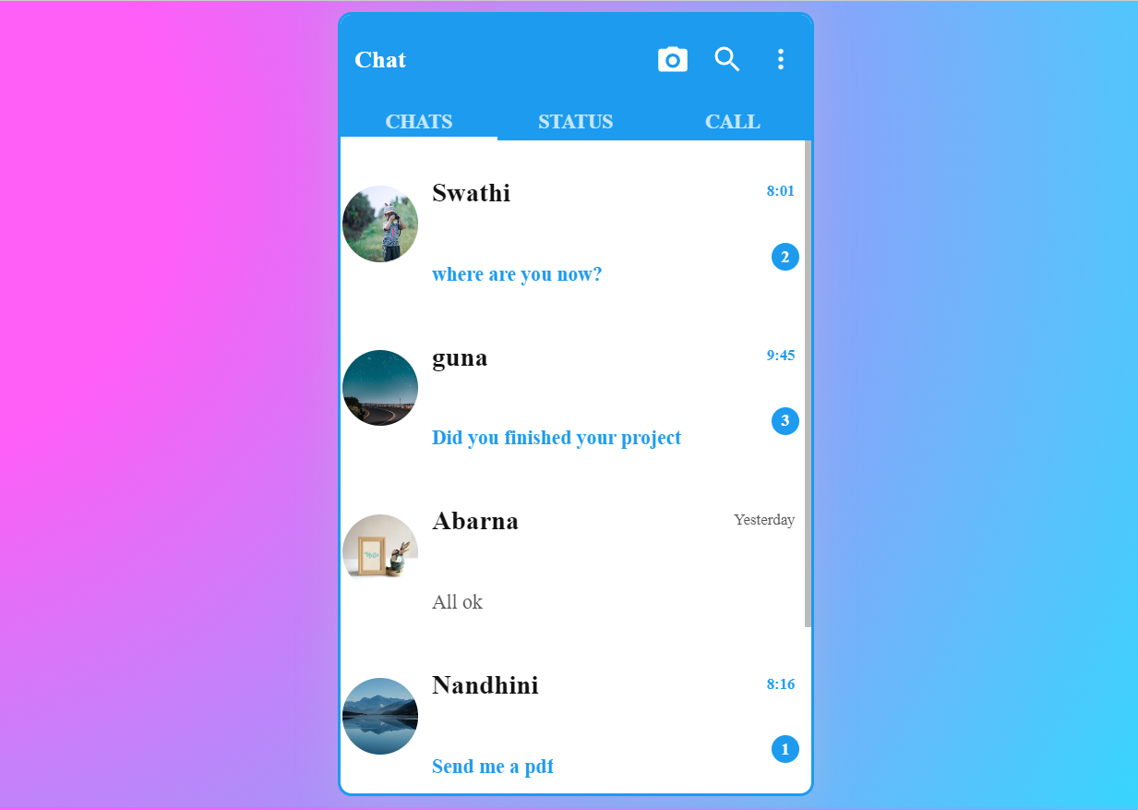
PROJECT SCREENSHOOT

Slide 8
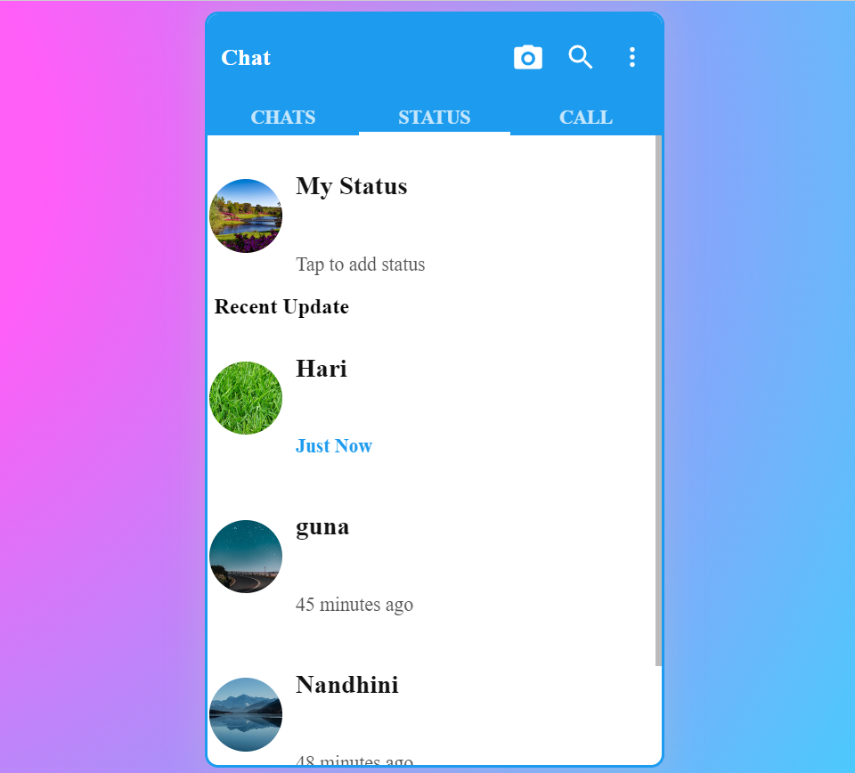

Slide 9
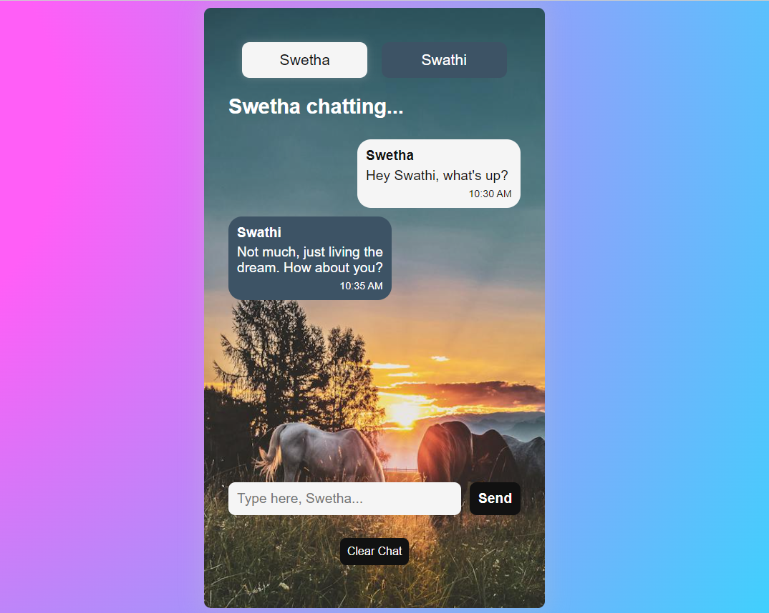

Slide 10
CONCLUSION
The application utilizes HTML, CSS, and JavaScript to create an
attractive and user-friendly interface.
Application is responsive in both system and hand device, and
user friendly
In future we can add other future like sending images, video
and audio.

Slide 11

THANK YOU…

